Slide 1
RDD project

Slide 2
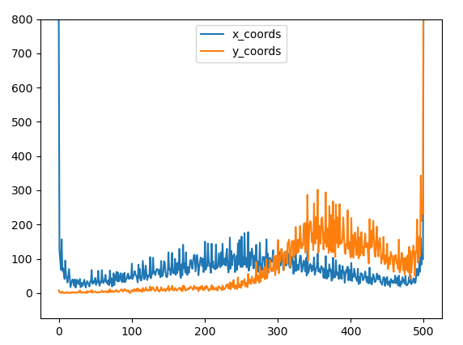
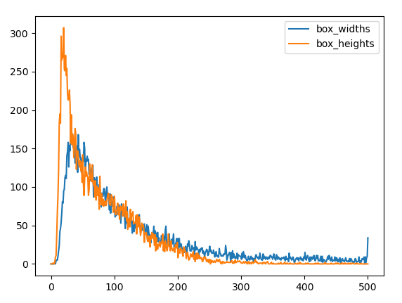
Dataset: RDD2020

Slide 3
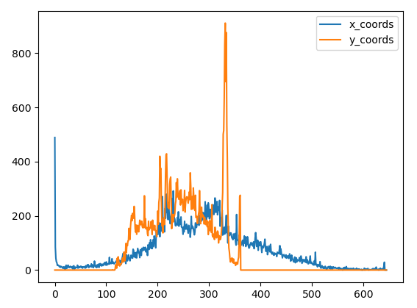
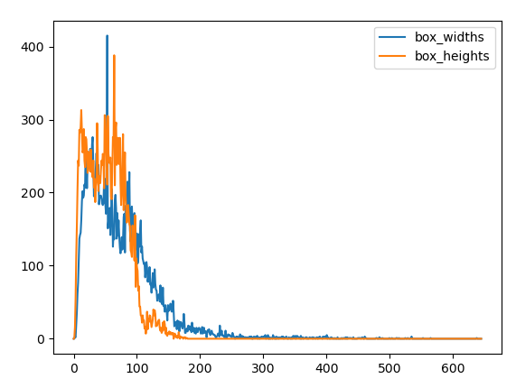
Dataset: TDT4265

Slide 4
Datasets: Classes

Slide 5
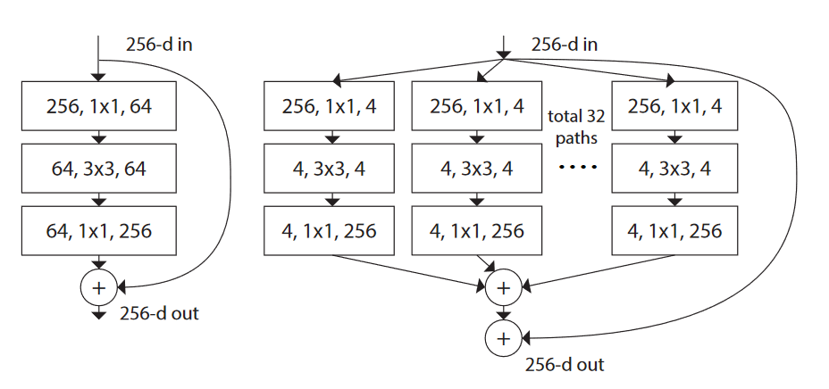
Backbone: ResNext50
Output size | # block
250x250x64 | 0 | Conv2d
 | 1 | BatchNorm2d
 | 2 | ReLU
125x125x64 | 3 | MaxPool2d
125x125x256 | 4 | Bottleneck0 Bottleneck1 Bottleneck2
63x63x512 | 5 | Bottleneck0 Bottleneck1 Bottleneck2 Bottleneck3
32x32x1024 | 6 | Bottleneck0 Bottleneck1 Bottleneck2 Bottleneck3 Bottleneck4 Bottleneck5
16x16x2048 | 7 | Bottleneck0 Bottleneck1 Bottleneck2

Slide 6
RDD2020: Training
Optimizer
Image size
Data augmentation
Priors settings
Weighted loss

Slide 7
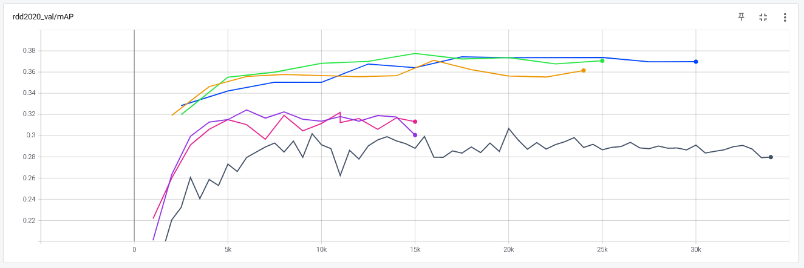
RDD2020: Results

Slide 8
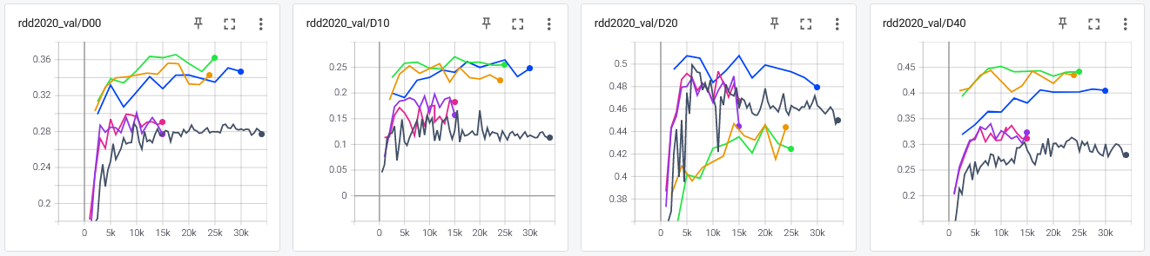
RDD2020: Results
Total runtime: 27.05731749534607
FPS: 3.6958578771602273

Slide 9
TDT4265: Training
Image size
Data augmentation
Priors settings
Weighted loss

Slide 10
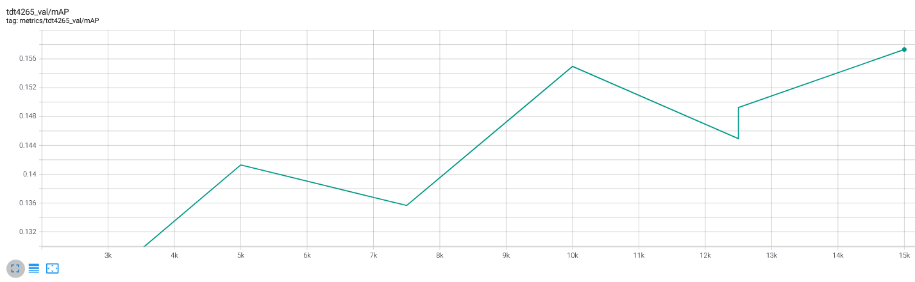
TDT4265 Result

Slide 11
Further work
Cropping
Tiling
Augmentation
Backbone model
More testing on TDT4265

Slide 12
Sources
Xie, S., et al., Aggregated Residual Transformations for Deep Neural Networks. arXiv pre-print server, 2017.
He, K., et al., Deep Residual Learning for Image Recognition. arXiv pre-print server, 2015.
Szegedy, C., et al., Rethinking the Inception Architecture for Computer Vision. arXiv pre-print server, 2015.
Ashia, et al., The Marginal Value of Adaptive Gradient Methods in Machine Learning. arXiv pre-print server, 2018.
Muthuraja, M., et al., Black-Box Optimization of Object Detector Scales. arXiv pre-print server, 2020.
Zoph, B., et al., Learning Data Augmentation Strategies for Object Detection. 2020, Springer International Publishing. p. 566-583.
Zhong, Z., et al., Random Erasing Data Augmentation. Proceedings of the AAAI Conference on Artificial Intelligence, 2020. 34(07): p. 13001-13008.
Trong and K. Yamamoto, Resolving Class Imbalance in Object Detection with Weighted Cross Entropy Losses. arXiv pre-print server, 2020.
Ozge Unel, F.a.O., Burak O. and Cigla, Cevahir, The Power of Tiling for Small Object Detection. 2019.
Li, Z., et al., DetNet: A Backbone network for Object Detection. arXiv pre-print server, 2018.

